Slide 1
Guyang Zhang SQL Oracle 21c Project
File created on: 2022-05-08 9:45:23 PM

Slide 2
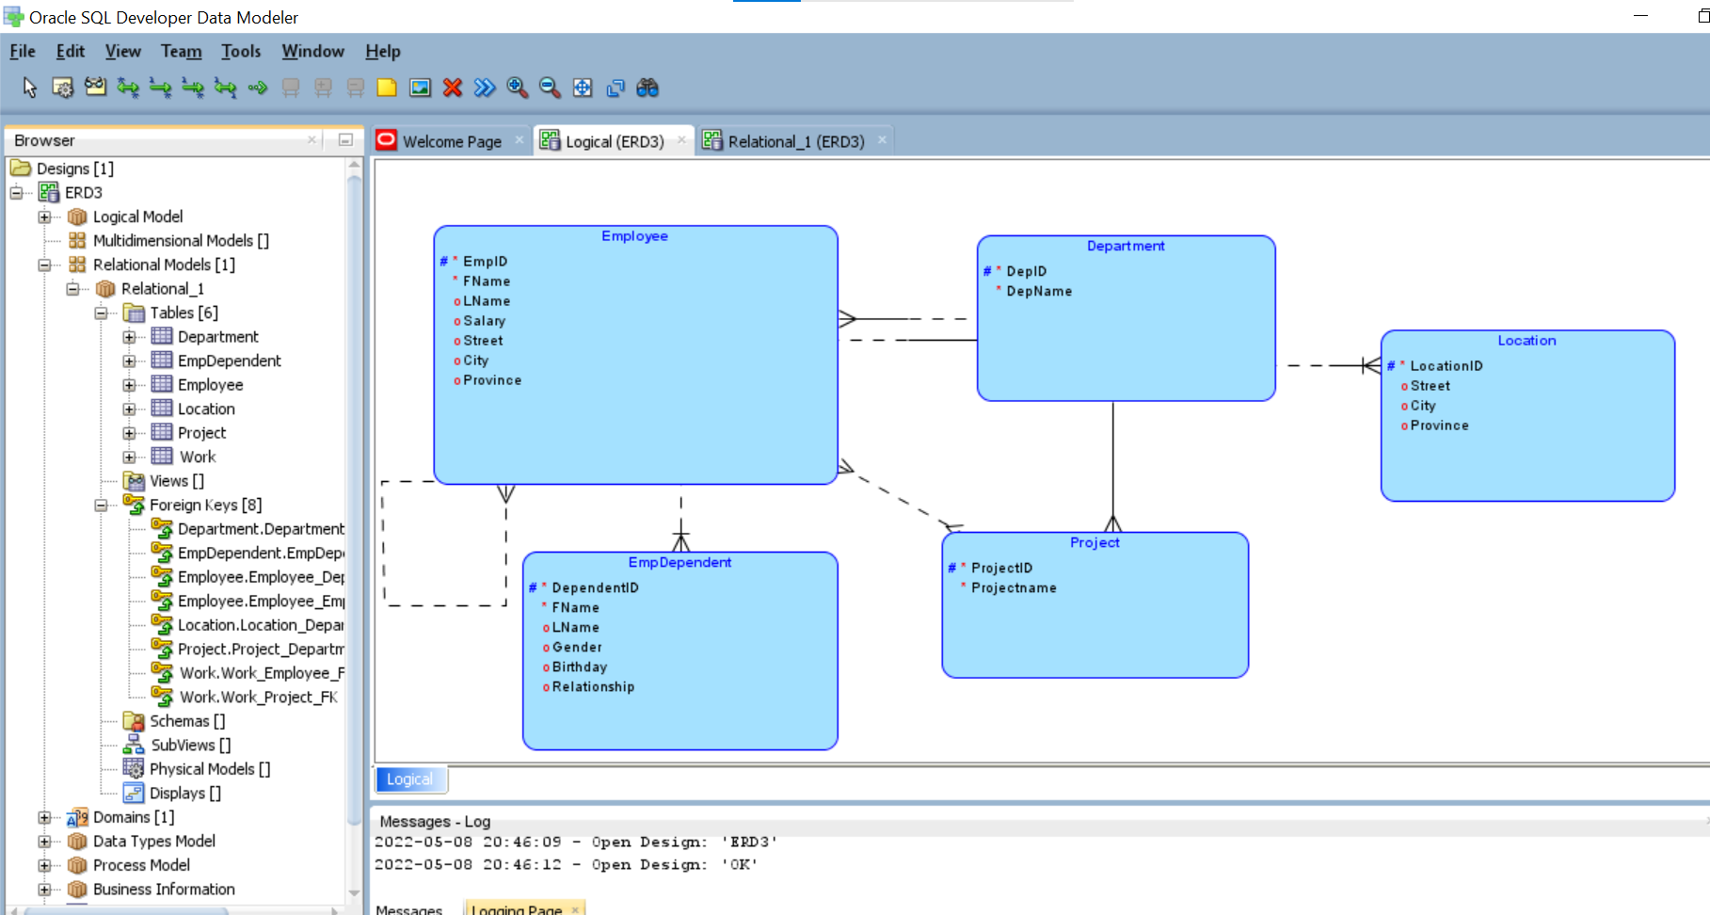

Slide 3
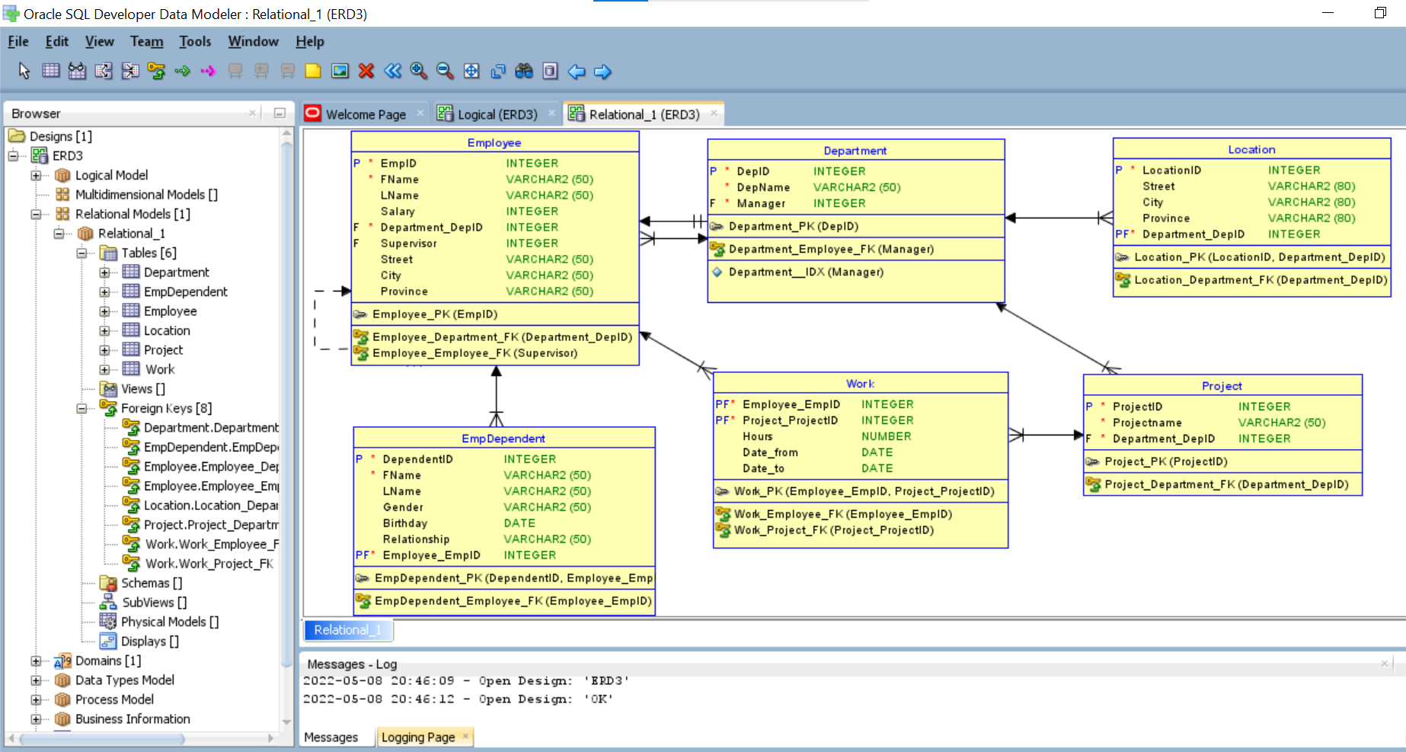

Slide 4
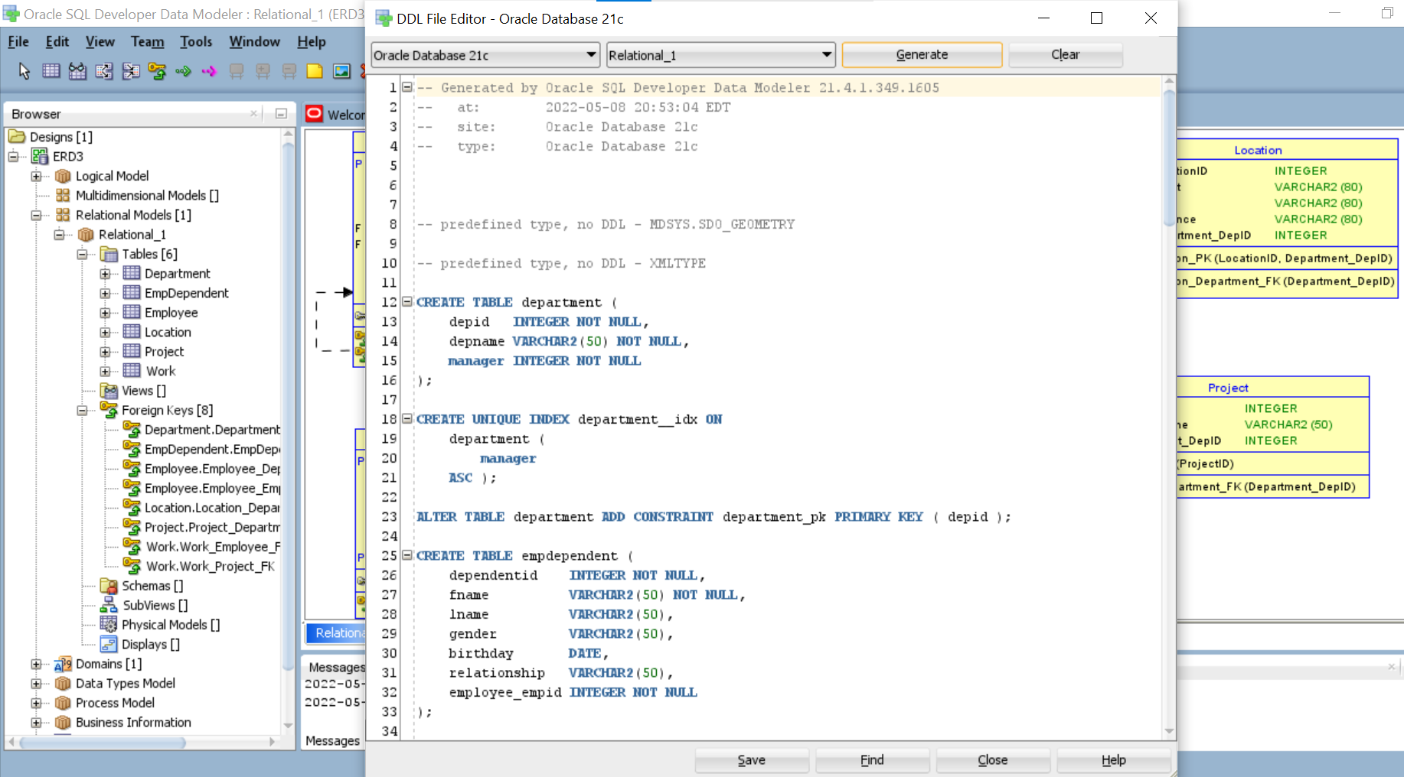

Slide 5
